Slide 1
Harnessing Simulation Data for a Prediction Model through Machine Learning
By Michael Schoemaker, Teodor Duhnev, Tobi Fagbule, Tian Tian, Kerim Ragimov, Karla Yepez

Slide 2
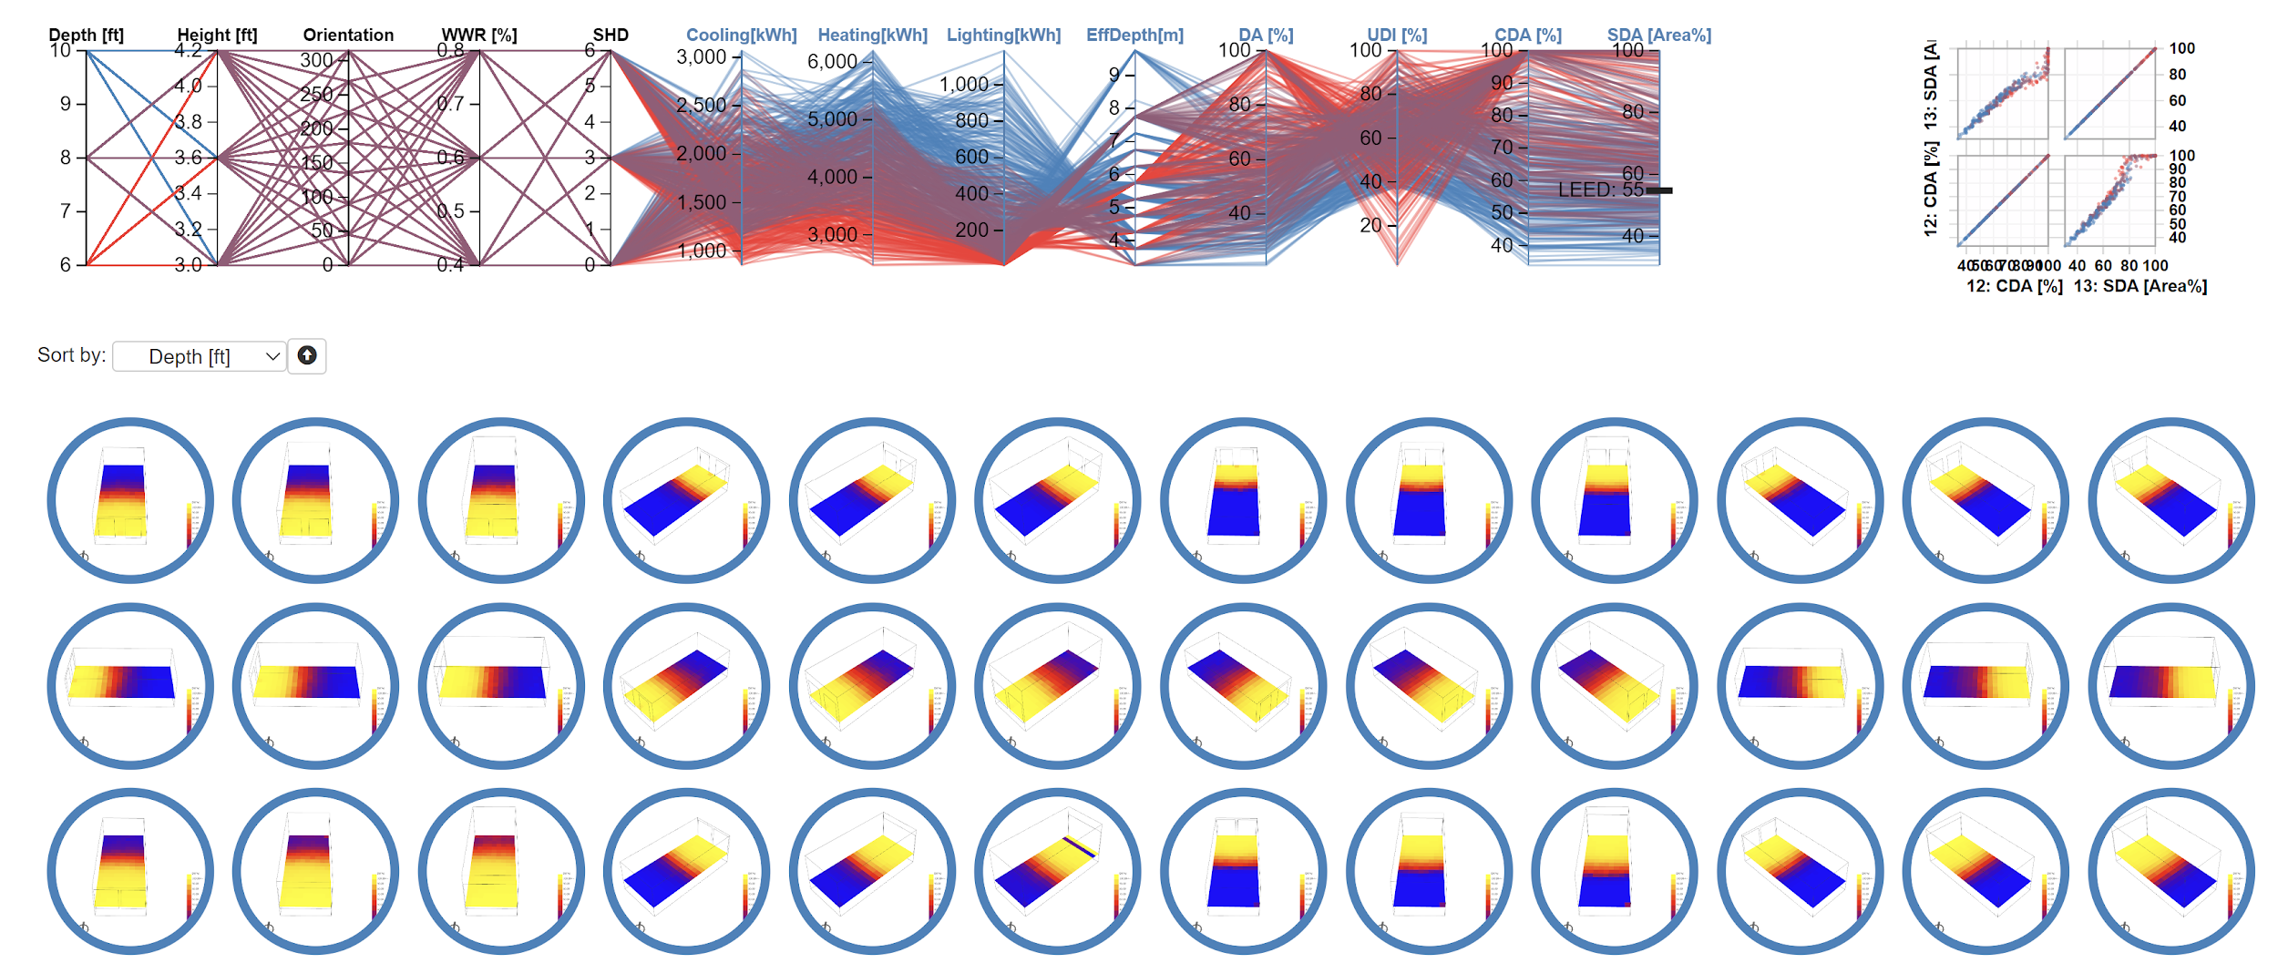
Data derived from Design explorer from TT Core

Slide 3
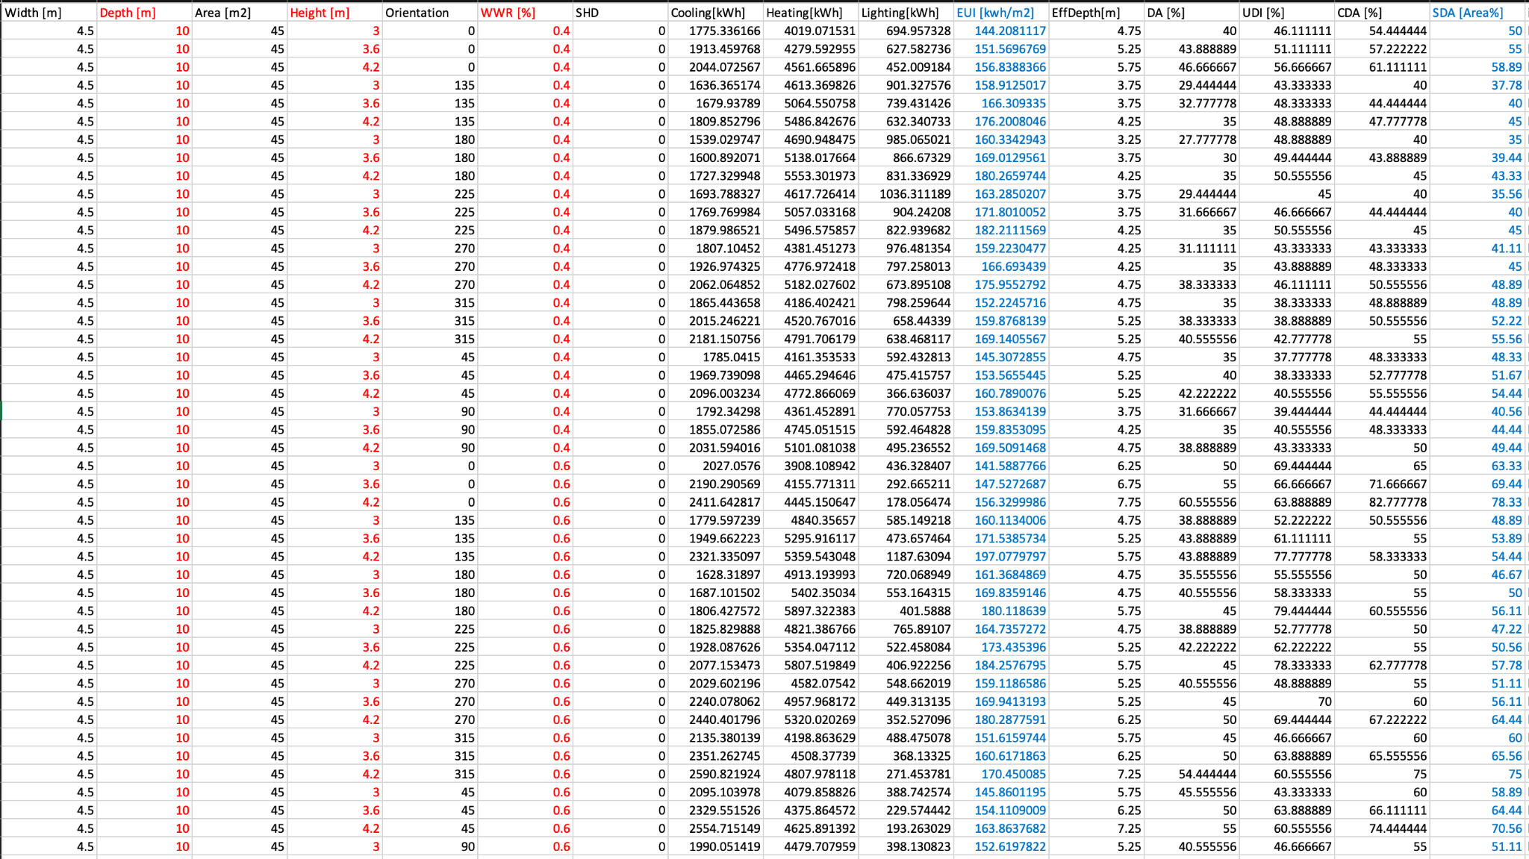
Red: Input , Blue: Output

Slide 4
Prediction Model

Slide 5
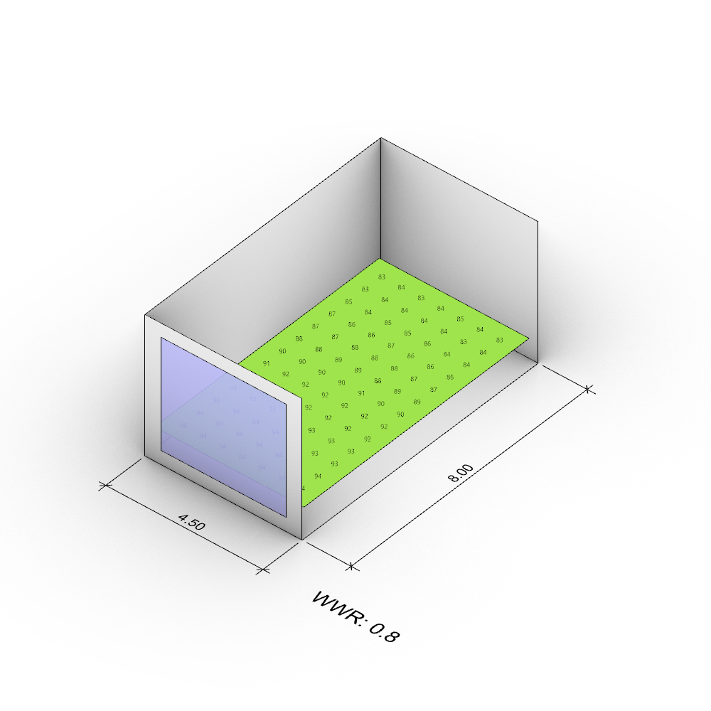
SDA Test
Width- 4.5m
Depth- 8m
Height- 4m
WWR- 0.8
89% Average
91.2% VS
Predicted

Slide 6
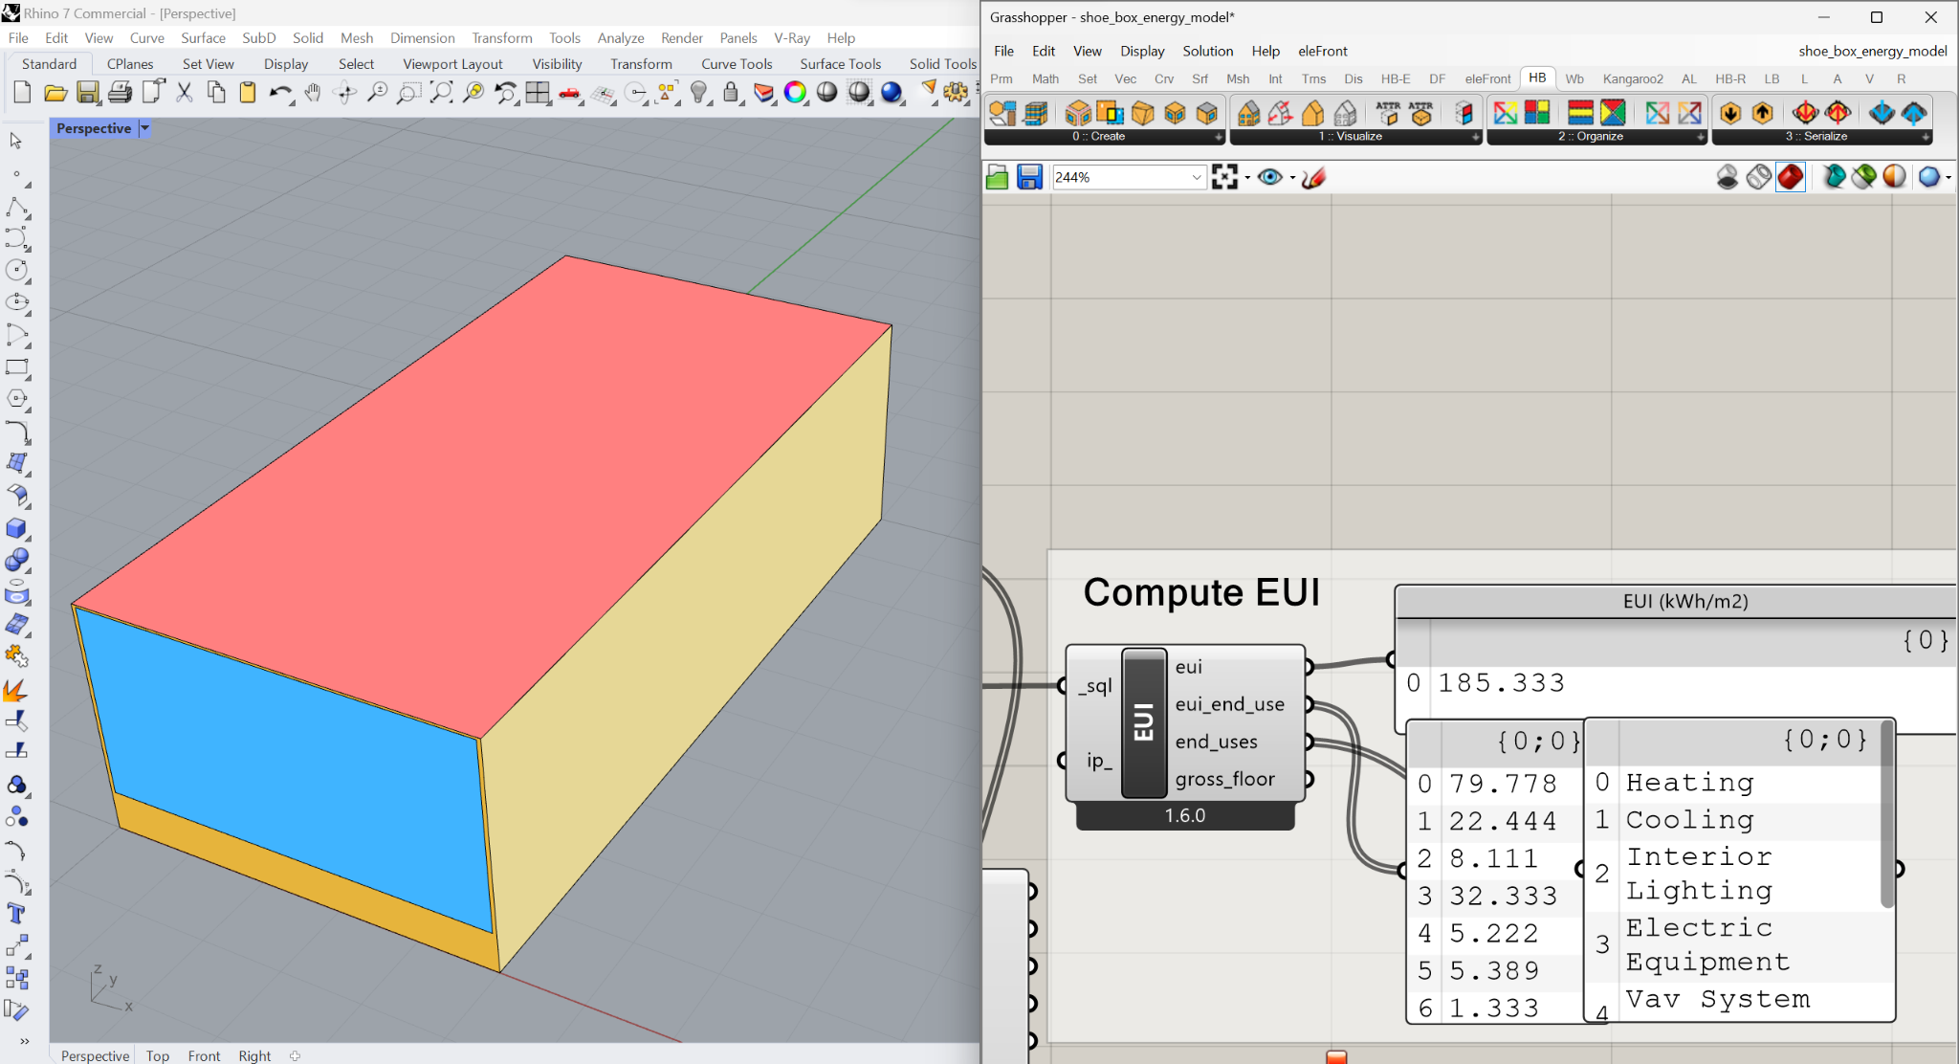
EUI Test
Width- 4.5m
Depth- 8m
Height- 4m
WWR- 0.8
185.3 Average
VS
187 Predicted

Slide 7
Community Scale Application

Slide 8
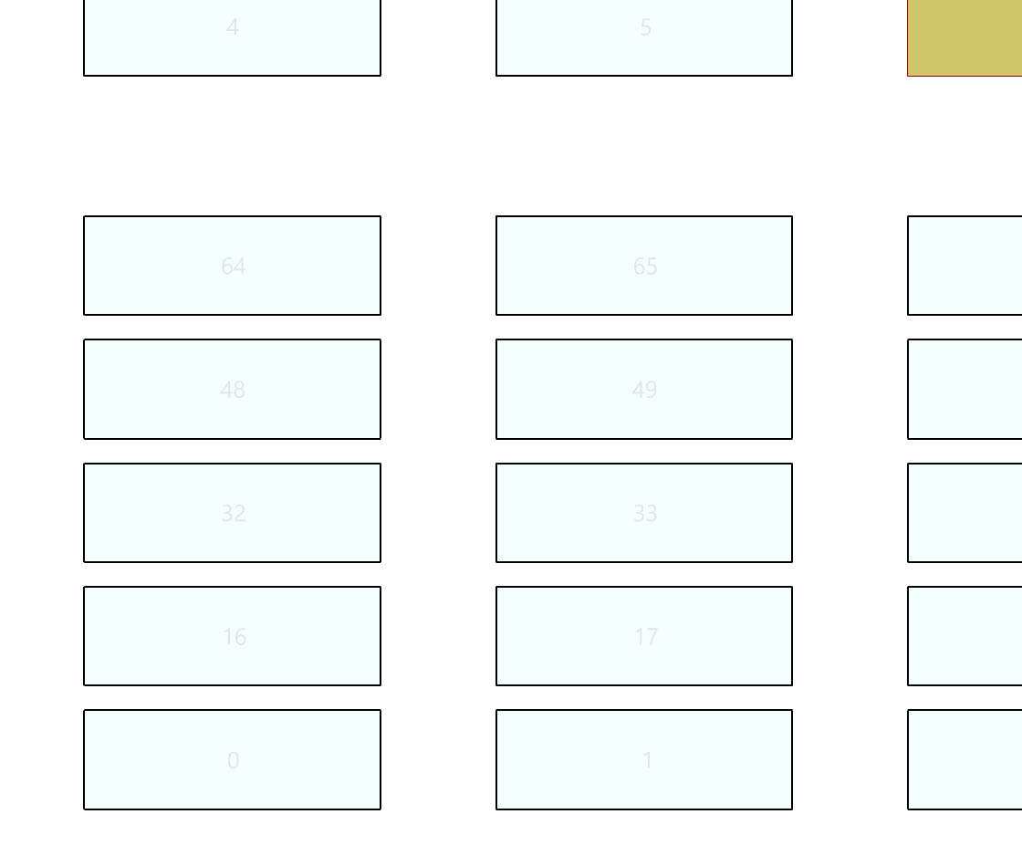
50m
7m
36m
7m
3m
15m
12m
Footprint building
Unit

Slide 9
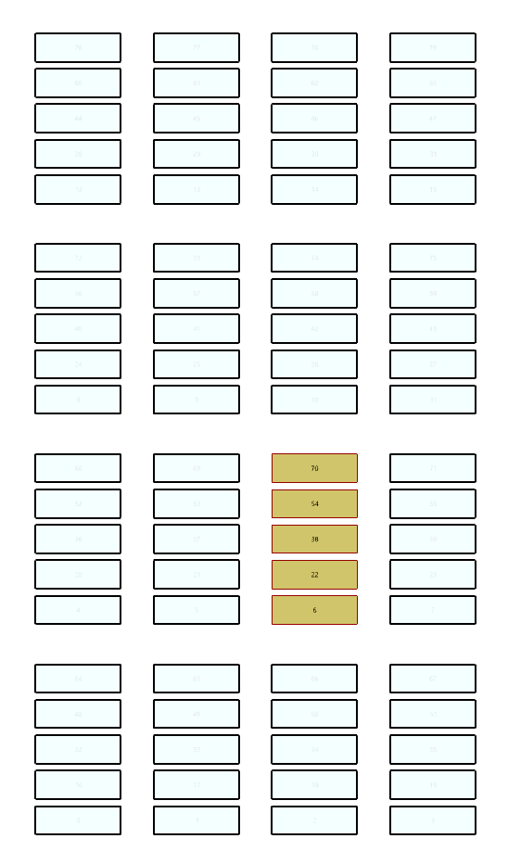
Rules:
Green Space:
Distance to green space <= 150m
Community:
Building height <= 23m
WWR = 0.5
Floor height 3m, 3.6m, 4.2m
Unit
Block
Community

Slide 10
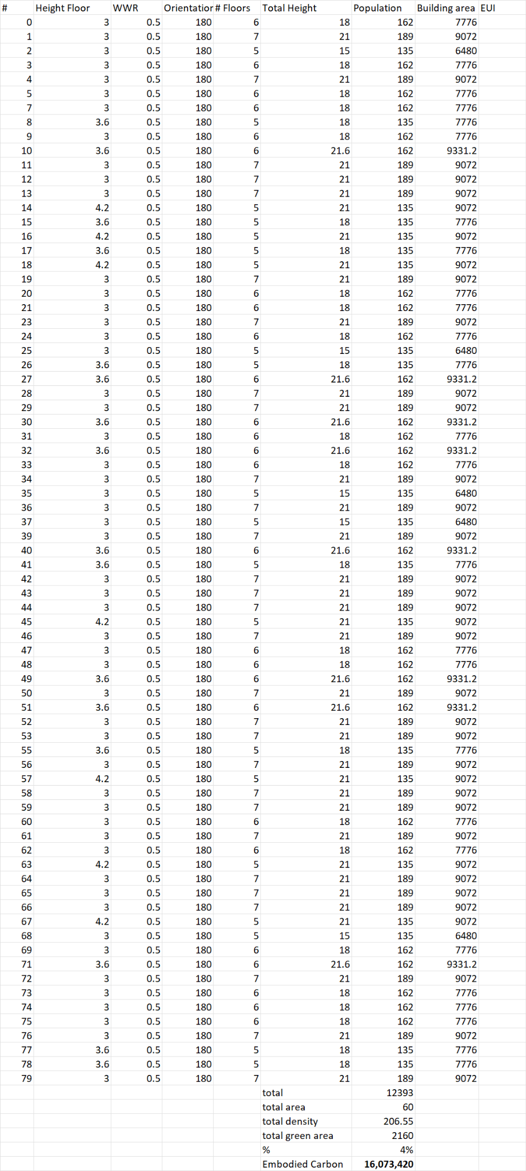
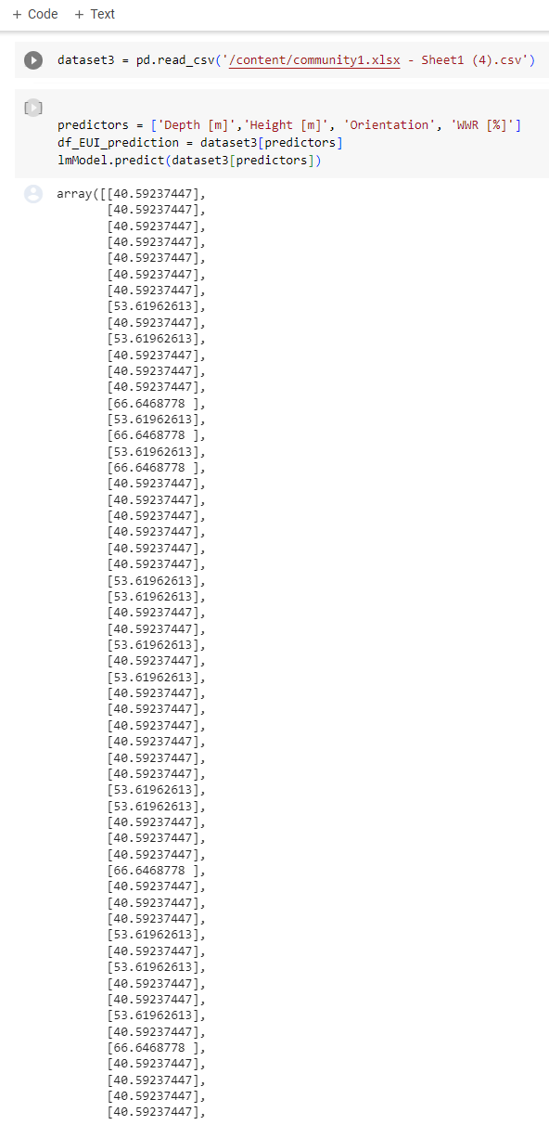
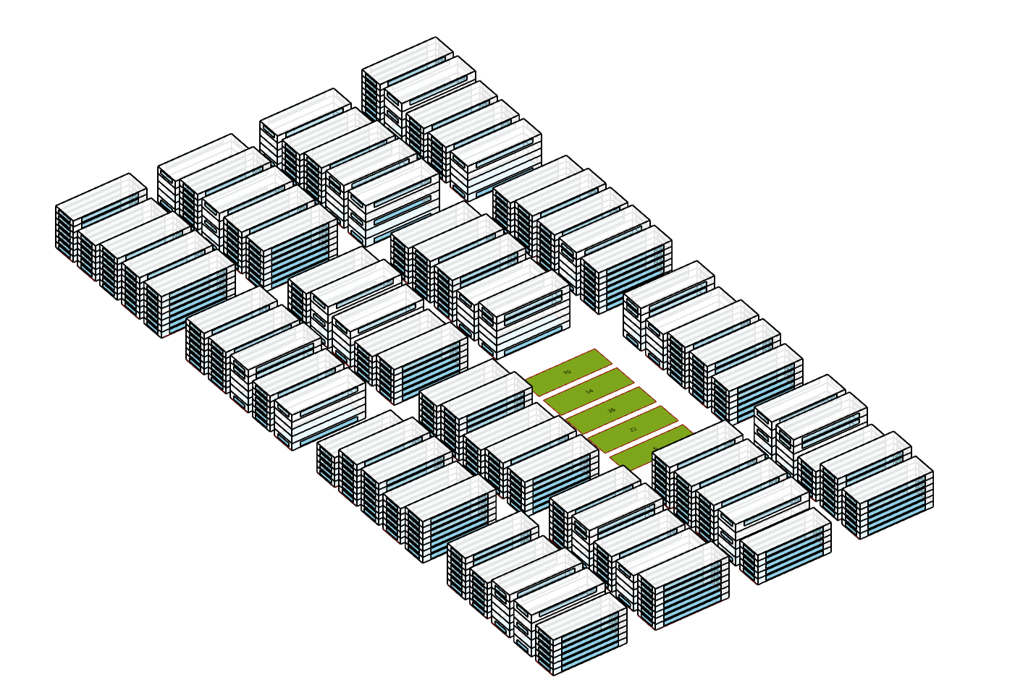
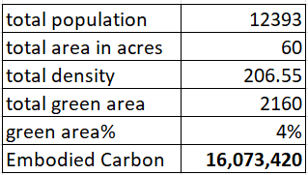
Option A

Slide 11
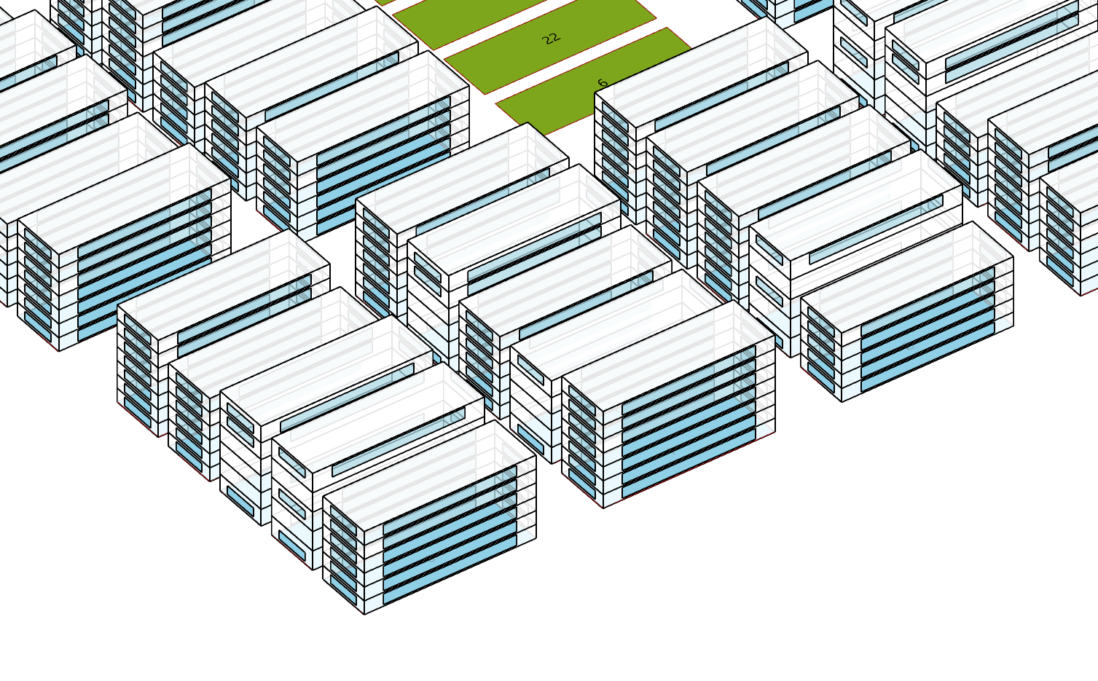
# Floors: 5
Height floor:4.2m
# Floors: 7
Height floor:3m
# Floors: 6
Height floor:3.6m

Slide 12
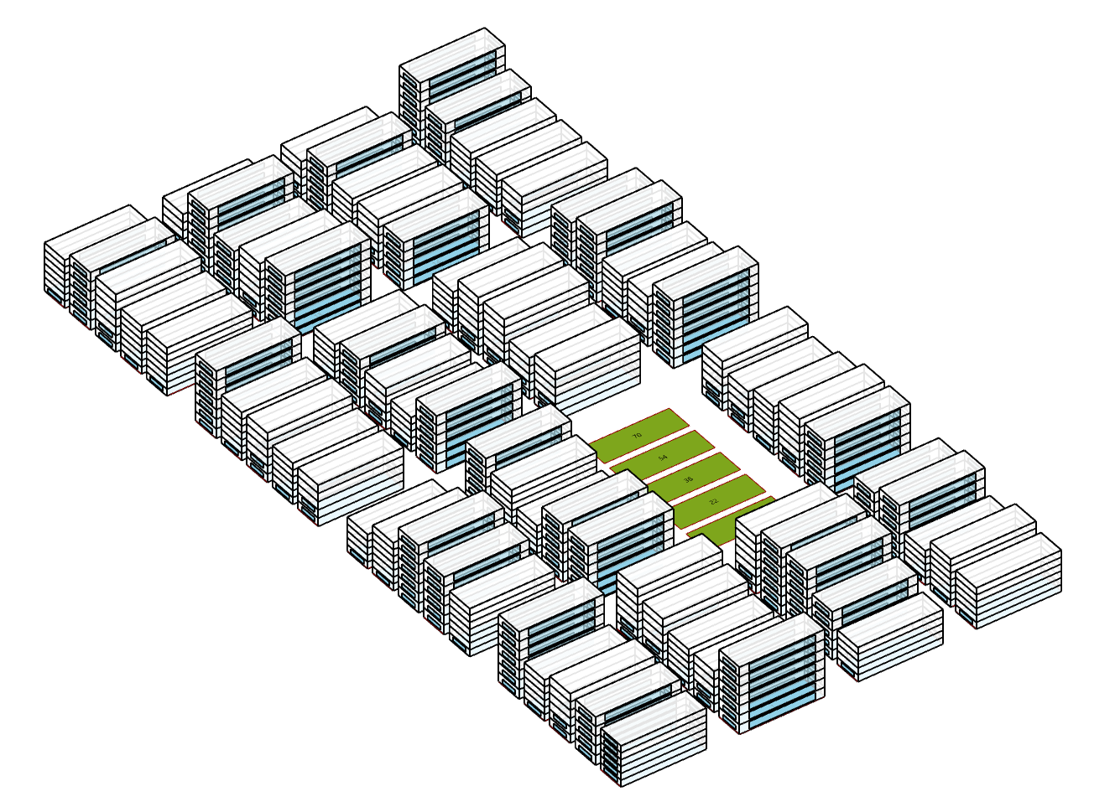
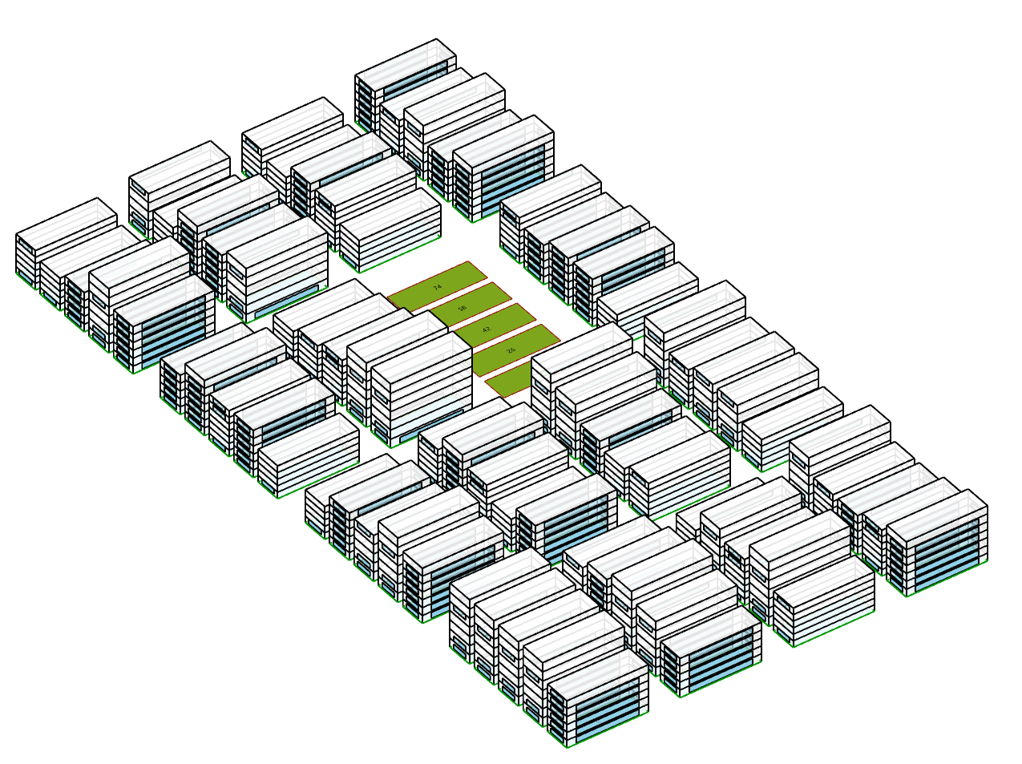
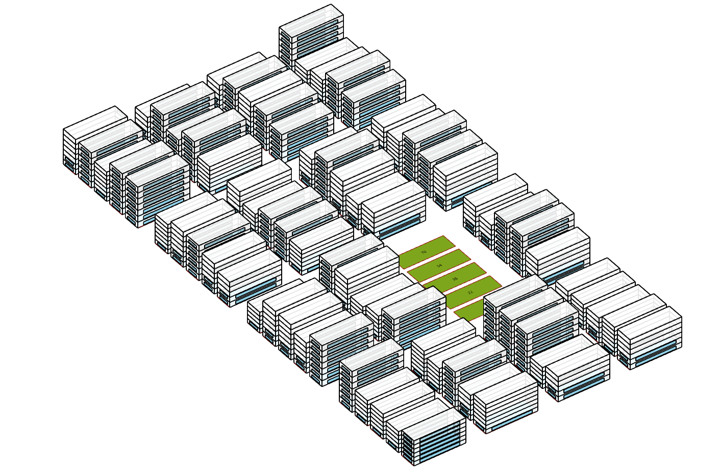
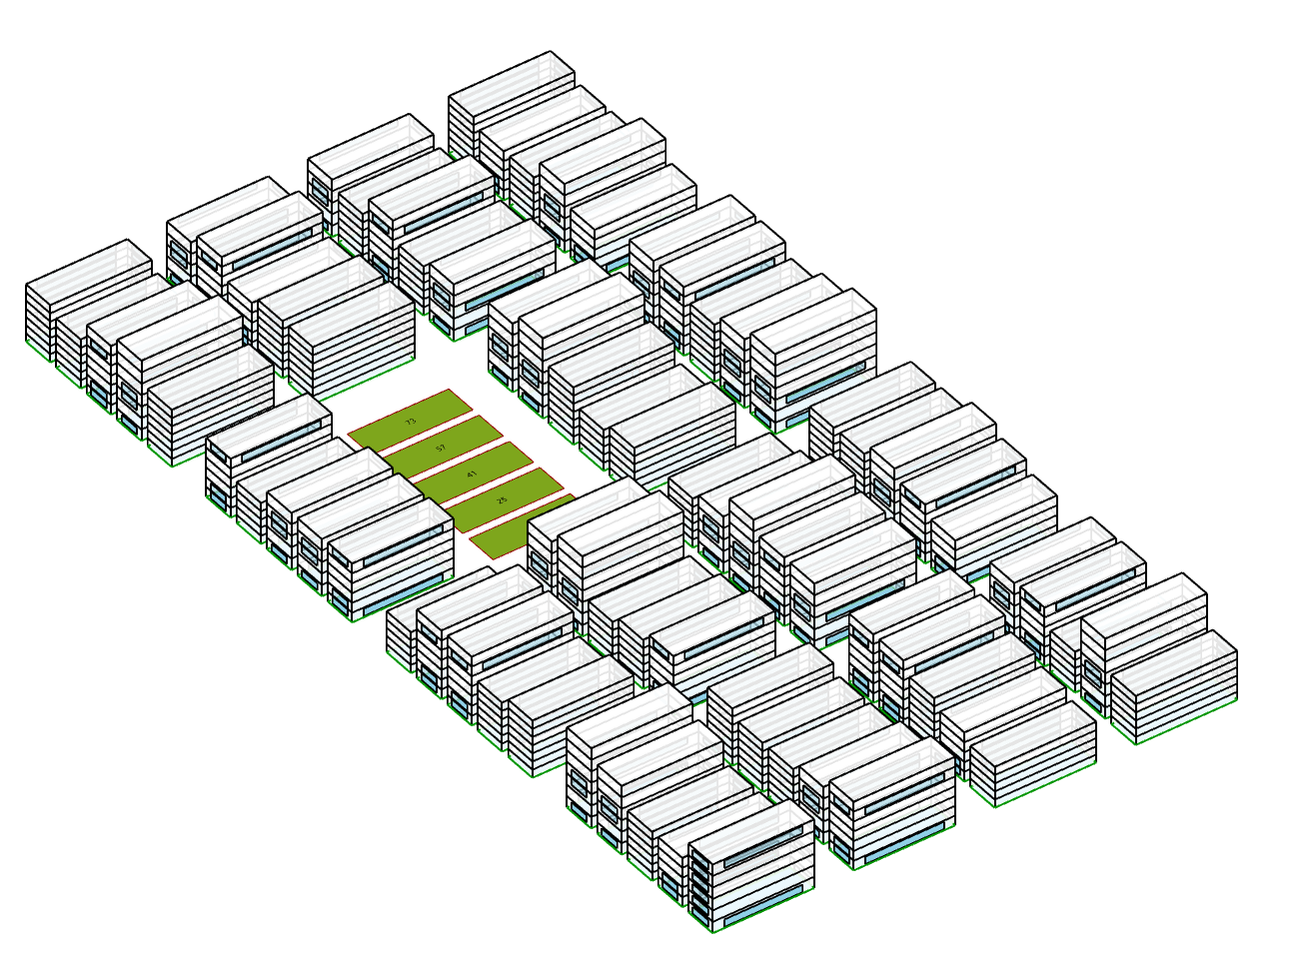
Other options

Slide 13
